Slide 1

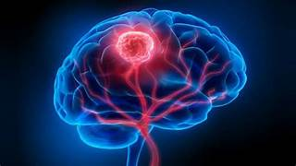
BRAIN TUMOR DETECTION USING MACHINE LEARNING
GUIDED BY :
Mr R VIJAYAGANTH
AP/AI
TEAM MEMBERS :
JOTHIKA MANGAI B (927621BAD018)
LIBERNA ASUWATHA A (927621BAD027)
SUPRIYA G (927621BAD055)

Slide 2
ABSTRACT
Brain tumor occurs owing to uncontrolled and rapid growth of cells. If not treated at an initial phase, it may lead to death. Despite many significant efforts and promising outcomes in this domain, accurate segmentation and classification remain a challenging task. A major challenge for brain tumor detection arises from the variations in tumor location, shape, and size.

Slide 3
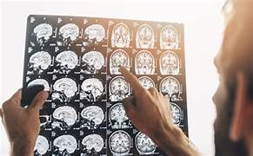
INTRODUCTION
Tumor defined as abnormal and uncontrollable growth of cells within an organ. Brain tumor is defined as an abnormal mass of tissue, with the cells multiplying and growing within brain tissue and eventually creating problems for normal brain function to continue.
Brain tumors are generally classified into 2 groups: benign (grades 1 and 2) and malignant (grades 3 and 4). Malignant tumors are also divided by aggressiveness, from minimally aggressive to highly aggressive tumors.

Slide 4
PROBLEM STATEMENT
Brain tumors are a significant health concern globally, with a high mortality rate if not detected and treated early. The existing methods for brain tumor detection often involve manual interpretation of medical imaging, which can be time-consuming, subject to human error, and may delay critical interventions. Therefore, the need for an accurate, efficient, and automated system for brain tumor detection is crucial.

Slide 5
STUDY OF EXISTING SYSTEM
CNNs have been widely used in medical image analysis, including brain tumor detection. These networks can automatically learn hierarchical features from medical images, making them suitable for tasks like tumor segmentation and classification.
Transfer learning involves using pre-trained neural network models on large datasets for tasks related to medical image analysis. Researchers often fine-tune these models on smaller, medical-specific datasets for brain tumor detection.
CDSS integrates machine learning models into the clinical workflow to assist healthcare professionals in making informed decisions. These systems aim to provide additional insights and support rather than replacing the expertise of radiologists.

Slide 6
PROPOSED SYSTEM
Implement advanced data augmentation techniques to artificially increase the diversity of the training dataset. Additionally, consider data synthesis approaches to generate additional realistic medical images, addressing data scarcity issues.
Optimize the model for real-time processing to enable quick diagnoses. Explore deployment options, including cloud-based solutions and edge computing, for efficient integration into clinical workflows.
Incorporate attention mechanisms within the neural network to focus on relevant regions of the medical images. This can enhance the model's ability to identify subtle patterns and anomalies associated with brain tumors.

Slide 7
CREATIVE IDEA OF THE PROJECT
Artistic Styles and Tumor Visualization
This artistic layer could help both medical professionals and patients better understand the imaging results.
Real-time AI Artistic Feedback
This feature enhances user engagement and promotes a personalized experience.
Interactive 3D Tumor Exploration
Develop an interactive 3D visualization tool that allows users to explore brain tumors in a virtual space.

Slide 8
PROPOSED METHODOLOGIES
Data Collection
Assemble a diverse dataset of brain MRI scans, including images with and without tumors.
Data Preprocessing
Address class imbalance if present by applying oversampling or undersampling techniques.
Image Feature Extraction:
Use Convolutional Neural Networks (CNNs) for automatic feature extraction.
3D Image Analysis
Extend the model to handle three-dimensional (3D) MRI scans, capturing volumetric information.

Slide 9
PROPOSED METHODOLOGIES
Data Augmentation
Apply data augmentation techniques to artificially increase the size of the training dataset.
Real-time Processing
Optimize the model for real-time processing, ensuring quick and efficient tumor detection.
Collaboration with Medical Professionals
Collaborate with healthcare professionals, radiologists, and medical institutions to gather domain-specific insights, validate results, and ensure the practical applicability of the proposed system.

Slide 10
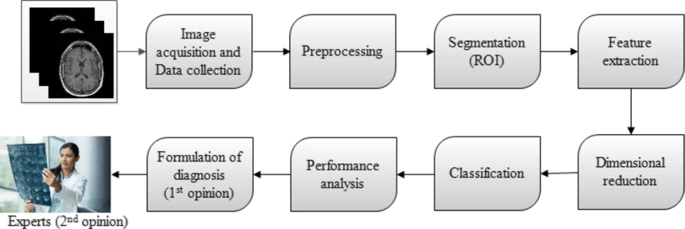
PROPOSED ARCHITECTURE

Slide 11


